Slide 1
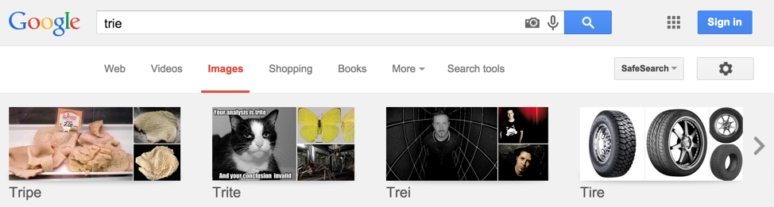
Tries
Lecture 28
CS61B, Spring 2024 @ UC Berkeley
Slides credit: Josh Hug

Slide 2
Tries (Conceptual)
Tries (Conceptual)
Trie Implementation and Performance
Alternate Child Tracking Strategies
Trie String Operations
Autocomplete
Trie Summary
Lecture 28, CS61B, Spring 2024

Slide 3
Abstract Data Types vs. Specific Implementations
There are many ways to implement an abstract data type.
Today we’ll talk about a new way to build a set/map.
Heap
Separate Chaining Hash Table
PQ
Balanced Tree
Ordered Linked List
Set
LinkedList
LinkedList
Resizing Array
List
Map
Resizing Array
BST (Vanilla)
Quick Find
LLRB
Quick Union
DisjointSets
B-Trees (2-3 / 2-3-4)
Weighted QU
Heap
WQUPC

Slide 4
BST and Hash Table Set Runtimes
Runtimes for our Balanced Search Tree and Hash Table implementations were very fast.
If we know that our keys all have some common special property, we can sometimes get even better implementations.
Example: Suppose we know our keys are always single ASCII characters.
e.g. ‘a’, ‘g’, ‘!’
 |  | contains(x) | add(x)
Balanced BST |  | Θ(log N) | Θ(log N)
Resizing Separate Chaining Hash Table |  | Θ(1) assuming even spread | Θ(1) on average, assuming even spread

Slide 5
Special Case 1: Character Keyed Map
Suppose we know that our keys are always ASCII characters.
Can just use an array!
Simple and fast.
 | key type | get(x) | add(x)
Balanced BST | comparable | Θ(log N) | Θ(log N)
Resizing Separate Chaining Hash Table | hashable | Θ(1) assuming even spread | Θ(1) on average, assuming even spread
data indexed array | chars | Θ(1) | Θ(1)
public class DataIndexedCharMap<V> {
private V[] items;
public DataIndexedCharMap(int R) {
items = (V[]) new Object[R];
}
public void put(char c, V val) {
items[c] = val;
}
public V get(char c) {
return items[c];
}
}
R is the number of possible characters, e.g. 128 for ASCII.

Slide 6
Special Case 2: String Keyed Map
Suppose we know that our keys are always strings.
Can use a special data structure known as a Trie.
Basic idea: Store each letter of the string as a node in a tree.
Tries will have great performance on:
get
add
special string operations
 | key type | get(x) | add(x)
Balanced BST | comparable | Θ(log N) | Θ(log N)
Resizing Separate Chaining Hash Table | hashable | Θ(1) assuming even spread | Θ(1) on average, assuming even spread
data indexed array | chars | Θ(1) | Θ(1)
Tries | Strings | ? | ?

Slide 7
Sets of Strings
Suppose we have a set containing “sam”, “sad”, “sap”, “same”, “a”, and “awls”.
Below, we see the BST and Hash Table representation.
sad
0
1
2
3
sad
sam
awls
awls
same
a
sap
a
sam
sap
same
BST
Hash Table

Slide 8
Tries: Each Node Stores One Character
For String keys, we can use a “Trie”. Key ideas:
Every node stores only one letter.
Nodes can be shared by multiple keys.
Above, we show the results of adding “sam” and sad”. Use your intuition to try to insert the remaining items “sap”, “same”, “a”, and “awls”.
s
a
d
m

Slide 9
Tries: Each Node Stores One Character
For String keys, we can use a “Trie”. Key ideas:
Every node stores only one letter.
Nodes can be shared by multiple keys.
Above, we show the results of adding “sam” and sad”. Use your intuition to try to insert the remaining items “sap”, “same”, “a”, and “awls”.
a
s
a
d
m
p
e

Slide 10
Tries: Each Node Stores One Character
For String keys, we can use a “Trie”. Key ideas:
Every node stores only one letter.
Nodes can be shared by multiple keys.
Try to figure out a way to make it clear that our set contains “sam”, “sad”, “sap”, “same”, “a”, and “awls”, but not “aw”, “awl”, “sa”, etc.
a
s
w
a
l
d
m
p
s
e

Slide 11
Tries: Each Node Stores One Character
For String keys, we can use a “Trie”. Key ideas:
Every node stores only one letter.
Nodes can be shared by multiple keys.
Try to figure out a way to make it clear that our set contains “sam”, “sad”, “sap”, “same”, “a”, and “awls”, but not “aw”, “awl”, “sa”, etc.
a
s
w
a
l
d
m
p
s
e

Slide 12
Tries: Search Hits and Misses
Suppose we insert “sam”, “sad”, “sap”, “same”, “a”, and “awls”.
contains(“sam”):
contains(“sa”):
contains(“a”):
contains(“saq”):
true, blue node
false, white node
true, blue node
“hit”
false, fell off tree
a
s
“miss”
w
a
Two ways to have a search “miss”:
If the final node is white.
If we fall off the tree, e.g. contains(“sax”).
l
d
m
p
s
e

Slide 13
Trie Maps
Tries can also be maps, of course.
b
s
t
y 4
e
h
h
a 6
l
e 0
o
e 5
e.g. maps “by” to 4.
l
l
r
s 1
l
e 7
s 3
For an animated demo of the creation of this map, see this demo from our optional Algorithms textbook.

Slide 14
Tries: A Digit-by-Digit Set Representation
a
s
sad
0
1
2
3
sad
sam
awls
w
a
awls
same
a
sap
l
d
m
p
a
sam
sap
same
s
e
BST
HashSet
Trie

Slide 15
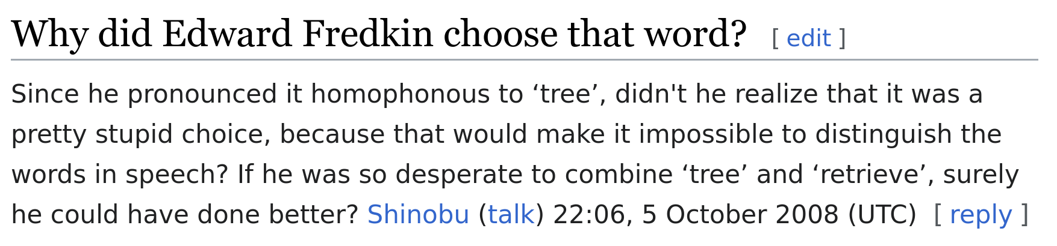
Tries
Trie:
Short for Retrieval Tree.
Inventor Edward Fredkin suggested it should be pronounced “tree”, but almost everyone pronounces it like “try”.

Slide 16
Trie Implementation and Performance
Tries (Conceptual)
Trie Implementation and Performance
Alternate Child Tracking Strategies
Trie String Operations
Autocomplete
Trie Summary
Lecture 28, CS61B, Spring 2024

Slide 17
Very Basic Trie Implementation
The first approach might look something like the code below.
Each node stores a letter, a map from c to all child nodes, and a color.
public class TrieSet {
private static final int R = 128; // ASCII
private Node root; // root of trie
private static class Node {
private char ch;
private boolean isKey;
private DataIndexedCharMap<Node> next;
private Node(char c, boolean b, int R) {
ch = c; isKey = b;
next = new DataIndexedCharMap<>(R);
}
}
}
a
s
w
a
l
d
m
p
Since we know our keys are characters, can use a DataIndexedCharMap.
s
e

Slide 18
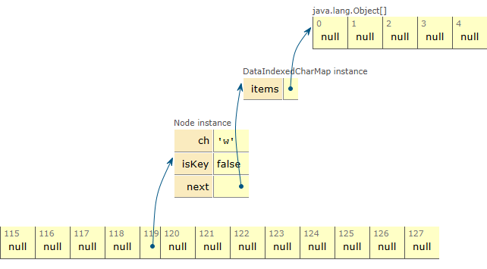
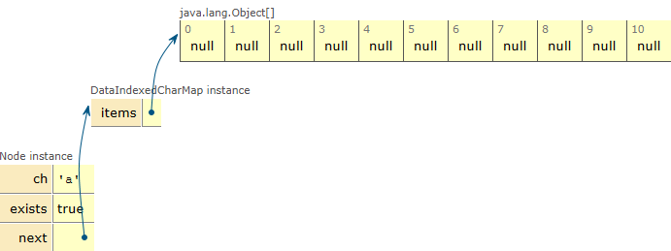
Zooming in On a Node
Each DataIndexedCharMap is an array of 128 possible links, mostly null.
private static class Node {
private char ch;
private boolean isKey;
private DataIndexedCharMap<Node> next;
private Node(char c, boolean b, int R) {
ch = c; isKey = b;
next = new DataIndexedCharMap<>(R);
}
...
...
a
w

Slide 19
Zooming in On a Node
Better drawing of a DataIndexedCharMap based trie is shown to the right.
private static class Node {
private char ch;
private boolean isKey;
private DataIndexedCharMap<Node> next;
private Node(char c, boolean b, int R) {
ch = c; isKey = b;
next = new DataIndexedCharMap<>(R);
}
128 links, with one used, and 127 equal to null.
a
a
w
w
...
w

Slide 20
Very Basic Trie Implementation
If we use a DataIndexedCharMap to track children, every node has R links.
private static class Node {
private char ch;
private boolean isKey;
private DataIndexedCharMap<Node> next;
private Node(char c, boolean b, int R) {
ch = c; isKey = b;
next = new DataIndexedCharMap<>(R);
}
a
s
a
...
s
w
a
...
w
...
a
public class DataIndexedCharMap<V> {
private V[] items;
public DataIndexedCharMap(int R) {
items = (V[]) new Object[R];
}
...
}
l
...
...
d
l
...
d
...
...

Slide 21
Very Basic Trie Implementation
Observation: The letter stored inside each node is actually redundant.
Can remove from the representation and things will work fine.
public class TrieSet {
private static final int R = 128; // ASCII
private Node root; // root of trie
private static class Node {
private char ch;
private boolean isKey;
private DataIndexedCharMap<Node> next;
private Node(char c, boolean b, int R) {
ch = c; isKey = b;
next = new DataIndexedCharMap<>(R);
}
}
}
a
s
...
w
a
...
...
l
...
...
d
...
...
...

Slide 22
Trie Performance in Terms of N
Given a Trie with N keys. What is the: [N = 6]
Add runtime?
Contains runtime?
a
s
...
w
a
...
...
l
...
...
...
d
m
p
s
e
...
...
...
...

Slide 23
Trie Performance in Terms of N
Given a Trie with N keys. What is the: [N = 6]
Add runtime? Θ(1)
Contains runtime? Θ(1)
Runtimes independent of number of keys!
Or in terms of L, the length of the key:
Add: Θ(L)
Contains: O(L)
a
s
...
w
a
...
...
l
...
...
...
d
m
p
s
e
...
...
...
...

Slide 24
Trie Performance in Terms of N
When our keys are strings, Tries give us slightly better performance on contains and add.
Runtimes treating length of keys as a constant
 | key type | get(x) | add(x)
Balanced BST | comparable | Θ(log N) | Θ(log N)
Resizing Separate Chaining Hash Table | hashable | Θ(1) assuming even spread | Θ(1) on average, assuming even spread
data indexed array | chars | Θ(1) | Θ(1)
Tries | Strings | Θ(1) | Θ(1)
One downside of the DataIndexedCharMap-based Trie is the huge memory cost of storing R links per node.
Wasteful because most links are unused in real world usage.

Slide 25
Alternate Child Tracking Strategies
Tries (Conceptual)
Trie Implementation and Performance
Alternate Child Tracking Strategies
Trie String Operations
Autocomplete
Trie Summary
Lecture 28, CS61B, Spring 2024

Slide 26
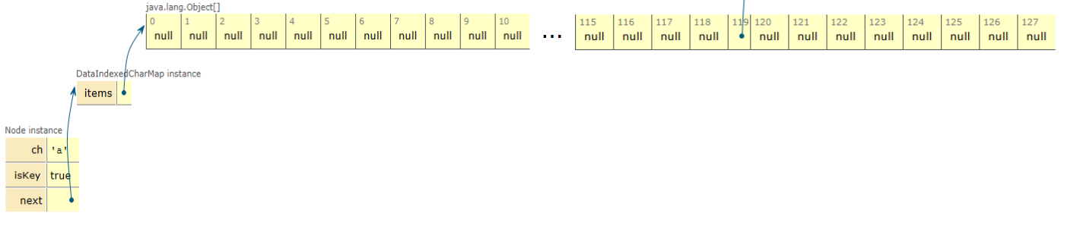
Trie Performance in Terms of N
Using a DataIndexedCharMap is very memory hungry.
Every node has to store R links, most of which are null.
private static class Node {
private boolean isKey;
private DataIndexedCharMap<Node> next;
private Node(char c, boolean b, int R) {
ch = c; isKey= b;
next = new DataIndexedCharMap<>(R);
}
a
s
w
a
l
d

Slide 27
The DataIndexedCharMap Trie
isKey:
F
links:
a
c
...
97
98
99
100
...
d
isKey:
isKey:
F
T
links:
links:
Can use ANY kind of map from character to node, e.g.
BST
Hash Table
...
97
98
99
100
...
...
97
98
99
100
...
isKey:
T
links:
Fundamental problem, our arrays are ‘sparse’.
...
97
98
99
100
...

Slide 28
Alternate Idea #1: The Hash-Table Based Trie
isKey:
F
links:
0
1
2
3
a
c
a
c
isKey:
F
isKey:
T
d
links:
links:
0
1
2
3
d
0
1
2
3

Slide 29
Alternate Idea #2: The BST-Based Trie
isKey:
F
links:
‘c’
‘a’
a
c
isKey:
F
isKey:
T
d
links:
links:
‘d’
isKey:
T
links:

Slide 30

The Three Trie Implementations
When we implement a Trie, we have to pick a map to our children
DataIndexedCharMap: Very fast, but memory hungry.
Hash Table: Almost as fast, uses less memory.
Balanced BST: A little slower than Hash Table, uses similar amount of memory?
dictionary from letter to Node
DataIndexedCharMap
this.next
Hash Table
Balanced BST

Slide 31
Performance of the DataIndexedCharMap, BST, and Hash Table Trie
Using a BST or a Hash Table to store links to children will usually use less memory.
DataIndexedCharMap: 128 links per node.
BST: C links per node, where C is the number of children.
Hash Table: C links per node.
Note: Cost per link is higher in BST and Hash Table.
Using a BST or a Hash Table will take slightly more time.
DataIndexedCharMap is Θ(1).
BST is O(log R), where R is size of alphabet.
Hash Table is O(R), where R is size of alphabet.
Since R is fixed (e.g. 128), can think of all 3 as Θ(1).
a
s
w
a
l
d
m
p
s
e

Slide 32
Trie Performance in Terms of N
When our keys are strings, Tries give us slightly better performance on contains and add.
Using BST or Hash Table will be slightly slower, but more memory efficient.
Would have to do computational experiments to see which is best for your application.
Runtimes treating length of keys as a constant
 | key type | get(x) | add(x)
Balanced BST | comparable | Θ(log N) | Θ(log N)
Resizing Separate Chaining Hash Table | hashable | Θ(1) assuming even spread | Θ(1) on average, assuming even spread
data indexed array | chars | Θ(1) | Θ(1)
Tries (BST, Hash Table, Data Indexed Char Map) | Strings | Θ(1) | Θ(1)
… but where Tries really shine is their efficiency with special string operations!

Slide 33
Trie String Operations
Tries (Conceptual)
Trie Implementation and Performance
Alternate Child Tracking Strategies
Trie String Operations
Autocomplete
Trie Summary
Lecture 28, CS61B, Spring 2024

Slide 34
String Specific Operations
Theoretical asymptotic speed improvement is nice. But the main appeal of tries is their ability to efficiently support string specific operations like prefix matching.
Finding all keys that match a given prefix: keysWithPrefix("sa")
Finding longest prefix of: longestPrefixOf("sample")
sad
0
1
2
3
sad
sam
a
s
awls
awls
same
w
a
a
sap
a
sam
sap
l
d
m
p
same
s
e

Slide 35
Prefix Matching Operations
Theoretical asymptotic speed improvement is nice. But the main appeal of tries is their ability to efficiently support string specific operations like prefix matching.
Examples:
Finding the longest prefix of a string: longestPrefixOf("sample")
Result: sam
Finding all keys that match a given prefix: keysWithPrefix("sa")
Result: [sad, sam, same, sap]
a
s
w
a
l
d
m
p
s
e

Slide 36
Challenging Warmup Exercise: Collecting Trie Keys
Challenging Exercise: Give an algorithm for collecting all the keys in a Trie.
collect() returns ["a", "awls", "sad", "sam", "same", "sap"]
a
s
w
a
l
d
m
p
s
e

Slide 37
Challenging Warmup Exercise: Collecting Trie Keys
Challenging Exercise: Give an algorithm for collecting all the keys in a Trie.
collect() returns ["a", "awls", "sad", "sam", "same", "sap"]
collect():
Create an empty list of results x.
For character c in root.next.keys():
Call colHelp(c, x, root.next.get(c)).
Return x.
colHelp(String s, List<String> x, Node n):
a
s
w
a
l
d
m
p
s
e

Slide 38
Challenging Warmup Exercise: Collecting Trie Keys
Challenging Exercise: Give an algorithm for collecting all the keys in a Trie.
collect() returns ["a", "awls", "sad", "sam", "same", "sap"]
collect():
Create an empty list of results x.
For character c in root.next.keys():
Call colHelp(c, x, root.next.get(c)).
Return x.
colHelp(String s, List<String> x, Node n):
If n.isKey, then x.add(s).
For character c in n.next.keys():
Call colHelp(s + c, x, n.next.get(c))
a
s
w
a
l
d
m
p
s
e

Slide 39
Challenging Warmup Exercise: Collecting Trie Keys
Challenging Exercise: Give an algorithm for collecting all the keys in a Trie.
collect():
Create an empty list of results x.
For character c in root.next.keys():
Call colHelp(c, x, root.next.get(c)).
Return x.
colHelp(String s, List<String> x, Node n):
If n.isKey, then x.add(s).
For character c in n.next.keys():
Call colHelp(s + c, x, n.next.get(c))
x = []
colHelp("a", x, )
s
a
w
a
l
d
m
p
s
e

Slide 40
Challenging Warmup Exercise: Collecting Trie Keys
Challenging Exercise: Give an algorithm for collecting all the keys in a Trie.
collect():
Create an empty list of results x.
For character c in root.next.keys():
Call colHelp(c, x, root.next.get(c)).
Return x.
colHelp(String s, List<String> x, Node n):
If n.isKey, then x.add(s).
For character c in n.next.keys():
Call colHelp(s + c, x, n.next.get(c))
x = ["a"]
colHelp("a", x, )
s
a
colHelp("aw", x, )
a
w
l
d
m
p
s
e

Slide 41
Challenging Warmup Exercise: Collecting Trie Keys
Challenging Exercise: Give an algorithm for collecting all the keys in a Trie.
collect():
Create an empty list of results x.
For character c in root.next.keys():
Call colHelp(c, x, root.next.get(c)).
Return x.
colHelp(String s, List<String> x, Node n):
If n.isKey, then x.add(s).
For character c in n.next.keys():
Call colHelp(s + c, x, n.next.get(c))
x = ["a"]
colHelp("a", x, )
s
a
colHelp("aw", x, )
a
w
colHelp("awl", x, )
l
d
m
p
s
e

Slide 42
Challenging Warmup Exercise: Collecting Trie Keys
Challenging Exercise: Give an algorithm for collecting all the keys in a Trie.
collect():
Create an empty list of results x.
For character c in root.next.keys():
Call colHelp(c, x, root.next.get(c)).
Return x.
colHelp(String s, List<String> x, Node n):
If n.isKey, then x.add(s).
For character c in n.next.keys():
Call colHelp(s + c, x, n.next.get(c))
x = ["a"]
colHelp("a", x, )
s
a
colHelp("aw", x, )
a
w
colHelp("awl", x, )
l
d
m
p
colHelp("awls", x, )
e
s

Slide 43
Challenging Warmup Exercise: Collecting Trie Keys
Challenging Exercise: Give an algorithm for collecting all the keys in a Trie.
collect():
Create an empty list of results x.
For character c in root.next.keys():
Call colHelp(c, x, root.next.get(c)).
Return x.
colHelp(String s, List<String> x, Node n):
If n.isKey, then x.add(s).
For character c in n.next.keys():
Call colHelp(s + c, x, n.next.get(c))
x = ["a", "awls"]
colHelp("a", x, )
s
a
colHelp("aw", x, )
a
w
colHelp("awl", x, )
l
d
m
p
colHelp("awls", x, )
e
s

Slide 44
Challenging Warmup Exercise: Collecting Trie Keys
Challenging Exercise: Give an algorithm for collecting all the keys in a Trie.
collect():
Create an empty list of results x.
For character c in root.next.keys():
Call colHelp(c, x, root.next.get(c)).
Return x.
colHelp(String s, List<String> x, Node n):
If n.isKey, then x.add(s).
For character c in n.next.keys():
Call colHelp(s + c, x, n.next.get(c))
x = ["a", "awls"]
a
s
colHelp("s", x, )
w
a
l
d
m
p
s
e

Slide 45
Challenging Warmup Exercise: Collecting Trie Keys
Challenging Exercise: Give an algorithm for collecting all the keys in a Trie.
collect():
Create an empty list of results x.
For character c in root.next.keys():
Call colHelp(c, x, root.next.get(c)).
Return x.
colHelp(String s, List<String> x, Node n):
If n.isKey, then x.add(s).
For character c in n.next.keys():
Call colHelp(s + c, x, n.next.get(c))
x = ["a", "awls"]
a
s
colHelp("s", x, )
colHelp("sa", x, )
w
a
l
d
m
p
s
e

Slide 46
Challenging Warmup Exercise: Collecting Trie Keys
Challenging Exercise: Give an algorithm for collecting all the keys in a Trie.
collect():
Create an empty list of results x.
For character c in root.next.keys():
Call colHelp(c, x, root.next.get(c)).
Return x.
colHelp(String s, List<String> x, Node n):
If n.isKey, then x.add(s).
For character c in n.next.keys():
Call colHelp(s + c, x, n.next.get(c))
x = ["a", "awls", "sad",
"sam", "same", "sap"]
a
s
colHelp("s", x, )
colHelp("sa", x, )
w
a
...
l
d
m
p
s
e

Slide 47
Usages of Tries
Challenge: Give an algorithm for keysWithPrefix.
Example: keysWithPrefix("sa") is ["sad", "sam", "same", "sap"].
a
s
w
a
l
d
m
p
s
e

Slide 48
Usages of Tries
Challenge: Give an algorithm for keysWithPrefix.
Example: keysWithPrefix("sa") is ["sad", "sam", "same", "sap"].
Algorithm:
Find the node α corresponding to the string (in pink).
Create an empty list x.
For character c in α.next.keys():
Call colHelp("sa" + c, x, α.next.get(c)).
Another common operation: LongestPrefixOf. See lab.
a
s
w
a
l
d
m
p
s
e

Slide 49
Autocomplete
Tries (Conceptual)
Trie Implementation and Performance
Alternate Child Tracking Strategies
Trie String Operations
Autocomplete
Trie Summary
Lecture 28, CS61B, Spring 2024

Slide 50

The Autocomplete Problem
Example, when I type “how are” into Google, I get 10 results, shown to the right.
One way to do this is to create a Trie based map from strings to values
Value represents how important Google thinks that string is.
Can store billions of strings efficiently since they share nodes.
When a user types in a string “hello”, we:
Call keysWithPrefix("hello").
Return the 10 strings with the highest value.

Slide 51
Autocomplete Example, for Top Three Matches
Suppose we have six strings with values shown below:
buck: 10
sad: 12
smog: 5
spit: 15
spite: 20
spy: 7
If the user types “s”, we:
Call keysWithPrefix("s").
sad, smog, spit, spite, spy
Return the three keys with highest value.
spit, spite, sad
b
s
u
a
m
p
c
12
i
d
o
y
7
10
g
t
k
5
15
e
20

Slide 52
Autocomplete Example, for Top Three Matches
Suppose we have six strings with values shown below:
buck: 10
sad: 12
smog: 5
spit: 15
spite: 20
spy: 7
If the user types “s”, we:
Call keysWithPrefix("s").
sad, smog, spit, spite, spy
Return the three keys with highest value.
spit, spite, sad
b
s
u
a
m
p
c
d
o
i
y
k
g
t
e

Slide 53

The Autocomplete Problem
One way to do this is to create a Trie based Dictionary that maps strings to values.
When a user types in a string hello, we:
Call keysWithPrefix("hello").
Return the ten strings with the highest value.
The approach above has one major flaw. If we enter a short string, the number of keys with the appropriate prefix will be too big.
We are collecting billions of results only to keep 10!
This is extremely inefficient.

Slide 54
A More Efficient Autocomplete
One way to address this issue:
Each node stores its own value, as well as the value of its best substring.
value = None
best = 20
None
20
None
10
b
s
None
10
None
12
None
5
None
20
u
a
m
p
20
None
10
c
12
12
None
5
None
20
7
7
d
o
i
y
10
10
5
5
15
20
k
g
t
20
20
e

Slide 55
A More Efficient Autocomplete
One way to address this issue:
Each node stores its own value, as well as the value of its best substring.
Search will consider nodes in order of “best”.
Consider ‘sp’ before ‘sm’.
Can stop when top 3 matches are all better than best remaining.
value = None
best = 20
None
20
None
10
b
s
None
10
None
12
None
5
None
20
u
a
m
p
20
None
10
c
12
12
None
5
None
20
7
7
d
o
i
y
10
10
5
5
15
20
k
g
t
20
20
e

Slide 56
Even More Efficient Autocomplete
Can also merge nodes that are redundant!
This version of trie is known as a “radix tree” or “radix trie”.
Won’t discuss.
value = None
best = 20
10
10
None
20
buck
s
12
12
5
5
None
20
ad
mog
p
20
15
20
7
7
it
y
20
20
e

Slide 57
Trie Summary
Tries (Conceptual)
Trie Implementation and Performance
Alternate Child Tracking Strategies
Trie String Operations
Autocomplete
Trie Summary
Lecture 28, CS61B, Spring 2024

Slide 58
Tries
When your key is a string, you can use a Trie:
Theoretically better performance than hash table or search tree.
Have to decide on a mapping from letter to node. Three natural choices:
DataIndexedCharMap, i.e. an array of all possible child links.
Bushy BST.
Hash Table.
All three choices are fine, though hash table is probably the most natural.
Supports special string operations like longestPrefixOf and keysWithPrefix.
keysWithPrefix is the heart of important technology like autocomplete.
Optimal implementation of Autocomplete involves use of a priority queue!
Bottom line: Data structures interact in beautiful and important ways!

Slide 59
Domain Specific Sets and Maps
More generally, we can sometimes take special advantage of our key type to improve our sets and maps.
Example: Tries handle String keys. Allow for fast string specific operations.
Note: There are many other types of string sets/maps out there.
Suffix Trees (Link).
DAWG (Link).
Won’t discuss in our course.

